Slide 1
Logical
SIEMENS
© 2015 John Sefcovic

Slide 2
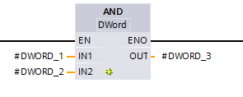
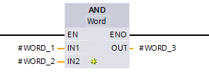
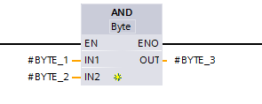
LOGICAL
The Logical instruction perform the AND, OR, XOR, and NOT logic functions bit-by-bit on the entire words specified in the instructions.
The IN1 may be a 32 bit DWORD, 16 bit WORD, 8 bit BYTE tag, the logical ‘0’ or ‘1’ at the bit position is logically operated on with corresponding bit position of the IN2 tag.
The logical result is stored in the corresponding bit of the OUT tag.

Slide 3
LOGICAL
For each corresponding bit position in the IN1 and IN2 words, there are four possible combinations of ‘0’ and ‘1’ states.
These different combinations are expressed in a TRUTH TABLE to determine the result for each possibility. The result depends on the Logical Function.
In this example, the possibilities at the same bit position in the two IN words.
TRUTH TABLE
IN 1 | IN 2 | OUT (Result)
0 | 0 | 0
0 | 1 | 0
1 | 0 | 0
1 | 1 | 1
First possible combination and result.
Second possible combination and result.
Third possible combination and result.
Fourth possible combination and result.

Slide 4
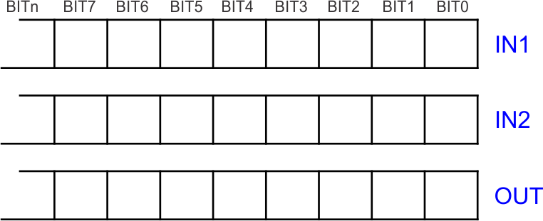
LOGICAL
The logical function would be performed on each bit of the entire IN words to determine a result in the OUT based on which combination was at the bit position.

Slide 5
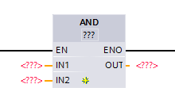
LOGICAL
AND
IN 1 | IN 2 | OUT (Result)
0 | 0 | 0
0 | 1 | 0
1 | 0 | 0
1 | 1 | 1
When rung conditions are true, the AND output instruction IN1 and IN2 are ANDed bit by bit and stored in the OUT. IN1 and IN2 can be either tags or constants; however, both sources cannot be a constant. The OUT must be an tag.

Slide 6
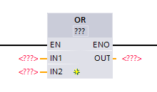
LOGICAL
OR
IN 1 | IN 2 | OUT (Result)
0 | 0 | 0
0 | 1 | 1
1 | 0 | 1
1 | 1 | 1
When rung conditions are true, the OR output instruction IN1 and IN2 are ORed bit by bit and stored in the OUT. IN1 and IN2 can be either tags or constants; however, both sources cannot be a constant. The OUT must be an tag.

Slide 7
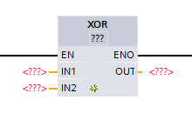
LOGICAL
XOR
IN 1 | IN 2 | OUT (Result)
0 | 0 | 0
0 | 1 | 1
1 | 0 | 1
1 | 1 | 0
When rung conditions are true, the XOR output instruction IN1 and IN2 are Exclusively ORed bit by bit and stored in the OUT. IN1 and IN2 can be either tags or constants; however, both sources cannot be a constant. The OUT must be an tag.

Slide 8
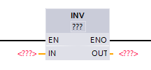
LOGICAL
INV
IN | OUT (Result)
0 | 1
1 | 0
When rung conditions are true, the INV (Inverse) instruction IN is INVERSED bit by bit and stored in the OUT. The IN and OUT must be tags.

Slide 9
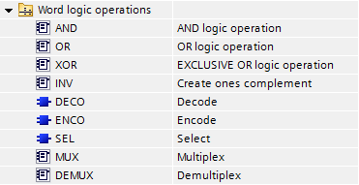
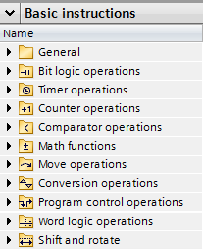
LOGICAL
The Logical instruction are Basic Instruction in the Word logic operations folder.

Slide 10

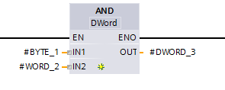
LOGICAL
TAGS and DATA
The Logical instruction uses 32 bit DWORD, 16 bit WORD, or 8 bit BYTE tags.
, an Implicit conversion changes the IN to the OUT data type for use in the instruction.
When mixed data types are used
It is the OUT which determines the data format.
Implicit conversion symbol.

Slide 11
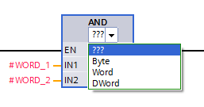
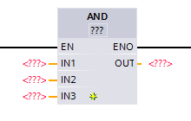
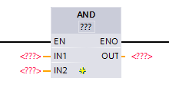
LOGICAL
The Data Type can be selected from the dropdown.
Multiple INs may be used.
Select the Insert in icon.

